Slide 1
Naming
Notes:
名称在所有计算机系统中都起着重要的作用。它们用来共享资源、惟一标识实体、指向位置。命名的一个重要结果是可以把名称解析为它所指向的实体。因而，名称解析允许进程访问命名实体。要解析名称，需要实现命名系统。分布式系统中的命名与非分布式系统中的命名之间的区别在于命名系统实现的方式。

Slide 2
Outline
Names Entities
Flat Naming
Structured Naming
Attribute-Based Naming
Notes:
1
2
3 flat names are good for machines, but are generally not very convenient for humans to use. As an alternative, naming systems generally support structured names that are composed from simple human readable names.
4 Finally, humans often prefer to describe entities by means of various characteristics, leading to a situation in which we need to resolve a description by means of attributes to an entity adhering to that description. This type of name resolution is notoriously difficult and we will pay separate attention to it.
分布式系统中的名称是由位或者字符所组成的串，它用来指向一个实体。分布式系统中的实体几乎可以是任何事物。典型的实例如主机、打印机、磁盘和文件等资源。通常得到明确命名的众所周知的其他实体实例还有进程、用户、邮箱、Web页面、网络连接，等等。
分布式系统中的名称都组织在通常所说的名称空间中。
名称空间为通过名称来存储和检索实体的信息提供了一套便利的机制。更一般地讲，给定一个路径名，应该能够查找出存储在该名称所指向的节点中的任何信息。查询名称的过程称为名称解析。

Slide 3
Outline
Names, identifiers, and addresses
Name resolution
Name space implementation

Slide 4
Naming
Essence: Names are used to denote entities in a distributed system. To operate on an entity, we need to access it at an access point. Access points are entities that are named by means of an address.
Note: A location-independent name for an entity E, is independent from the addresses of the access points offered by E.

Slide 5
Identifiers
Pure name: A name that has no meaning at all; it is just a random string. Pure names can be used for comparison only.
Identifier: A name having the following properties:
  P1: Each identifier refers to at most one entity
  P2: Each entity is referred to by at most one identifier
  P3: An identifier always refers to the same entity (prohibits reusing an identifier)
Observation: An identifier need not necessarily be a pure name, i.e., it may have content.

Slide 6
5.2 Flat Naming
Observation: In many cases, identifiers are simply random bit strings, which we conveniently refer to as unstructured, or flat names.
Problem: Given an essentially unstructured, how can we locate its associated access point?
  Simple solutions (broadcasting)
  Forwarding Pointers
  Home-based approaches
  Distributed Hash Tables (structured P2P)
  Hierarchical location service

Slide 7
Simple Solutions
Broadcasting: Simply broadcast the ID, requesting the entity to return its current address.
  Can never scale beyond local-area networks (think of ARP/RARP)
  Requires all processes to listen to incoming location requests
Forwarding pointers: Each time an entity moves, it leaves behind a pointer telling where it has gone to.
  Dereferencing can be made entirely transparent to clients by simply following the chain of pointers
  Update a client’s reference as soon as present location has been found
  Geographical scalability problems (for which separate chain reduction mechanisms are needed):
    Long chains are not fault tolerant
    Increased network latency at dereferencing
Notes:
In computer networking, the Address Resolution Protocol (ARP) is the method for finding a host's link layer (hardware) address when only its Internet Layer (IP) or some other Network Layer address is known. ARP is defined in RFC 826.[1] It is Internet Standard STD 37.

Slide 8
Home-Based Approaches (1/3)
Single-tiered scheme: Let the home keep track where the entity is
  Entity’s home address is registered at a naming service.
  The home registers the foreign address of the entity
  Clients always contact the home first, and then continue with the foreign location

Slide 9
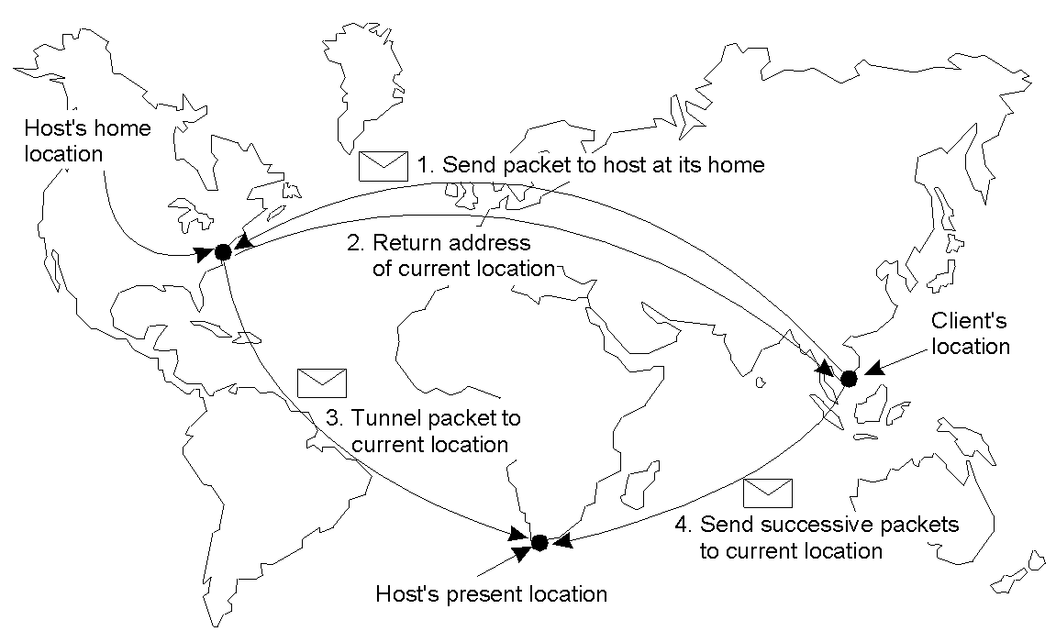
Home-Based Approaches (2/3)
Notes:
Figure 5-3. The principle of Mobile IP
The figure also illustrates another drawback of home-based approaches in large scale networks. …. Increase in communication latency.

Slide 10
Home-Based Approaches (3/3)
Two-tiered scheme: Keep track of visiting entities:
  Check local visitor register first
  Fall back to home location if local lookup fails
Problems with home-based approaches
  Home address has to be supported for entity’s lifetime
  Home address is fixed ) unnecessary burden when the entity permanently moves
  Poor geographical scalability (entity may be next to client)
Question: How can we solve the “permanent move” problem?

Slide 11
Distributed Hash Tables
Chord: Consider the organization of many nodes into a logical ring
  Each node is assigned a random m-bit identifier.
  Every entity is assigned a unique m-bit key.
  Entity with key k falls under jurisdiction of node with smallest id ≥ k (called its successor).
Nonscalable Solution:
  Let node id keep track of succ(id) and start linear search along the ring.
Notes:
jurisdiction
[7dVuEris5dikFEn]
n.
权限

Slide 12
DHTs: Finger Tables (1/2)
Princeple
Each node p maintains a finger table FT_{p}[] with at most m entries:
FT_{p}[i] = succ(p + 2^{i−1})
Note: FT_{p}[i] points to the first node succeeding p by at least 2^{i−1}.
To look up a key k, node p forwards the request to node with index j satisfying
q = FT_{p}[j] ≤k < FT_{p}[j + 1]
If p < k < FT_{p}[1], the request is also forwarded to FT_{p}[1]

Slide 13
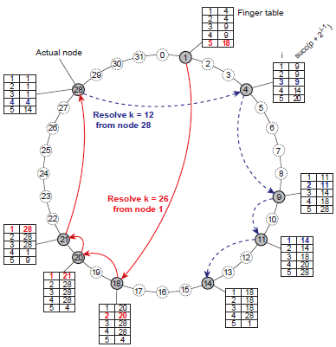
DHTs: Finger Tables (2/2)

Slide 14
Exploiting Network Proximity
Problem: The logical organization of nodes in the overlay may lead to erratic message transfers in the underlying Internet: node k and node succ(k +1) maybe very far apart.
Topology-aware node assignment: When assigning an ID to a node, make sure that nodes close in the ID space are also close in the network. Can be very difficult.
Proximity routing: Maintain more than one possible successor, and forward to the closest.
  Example: in Chord FT_{p}[i] points to first node in INT = [p + 2^{i−1}, p + 2^{i − 1}]. Node p can also store pointers to other nodes in INT.
Proximity neighbor selection: When there is a choice of selecting who your neighbor will be (not in Chord), pick the closest one.
Notes:
erratic
[i'rætik]
adj.
不稳定的, 无规律的, 漂泊的
反复无常的, 古怪的; 乖僻的

Slide 15
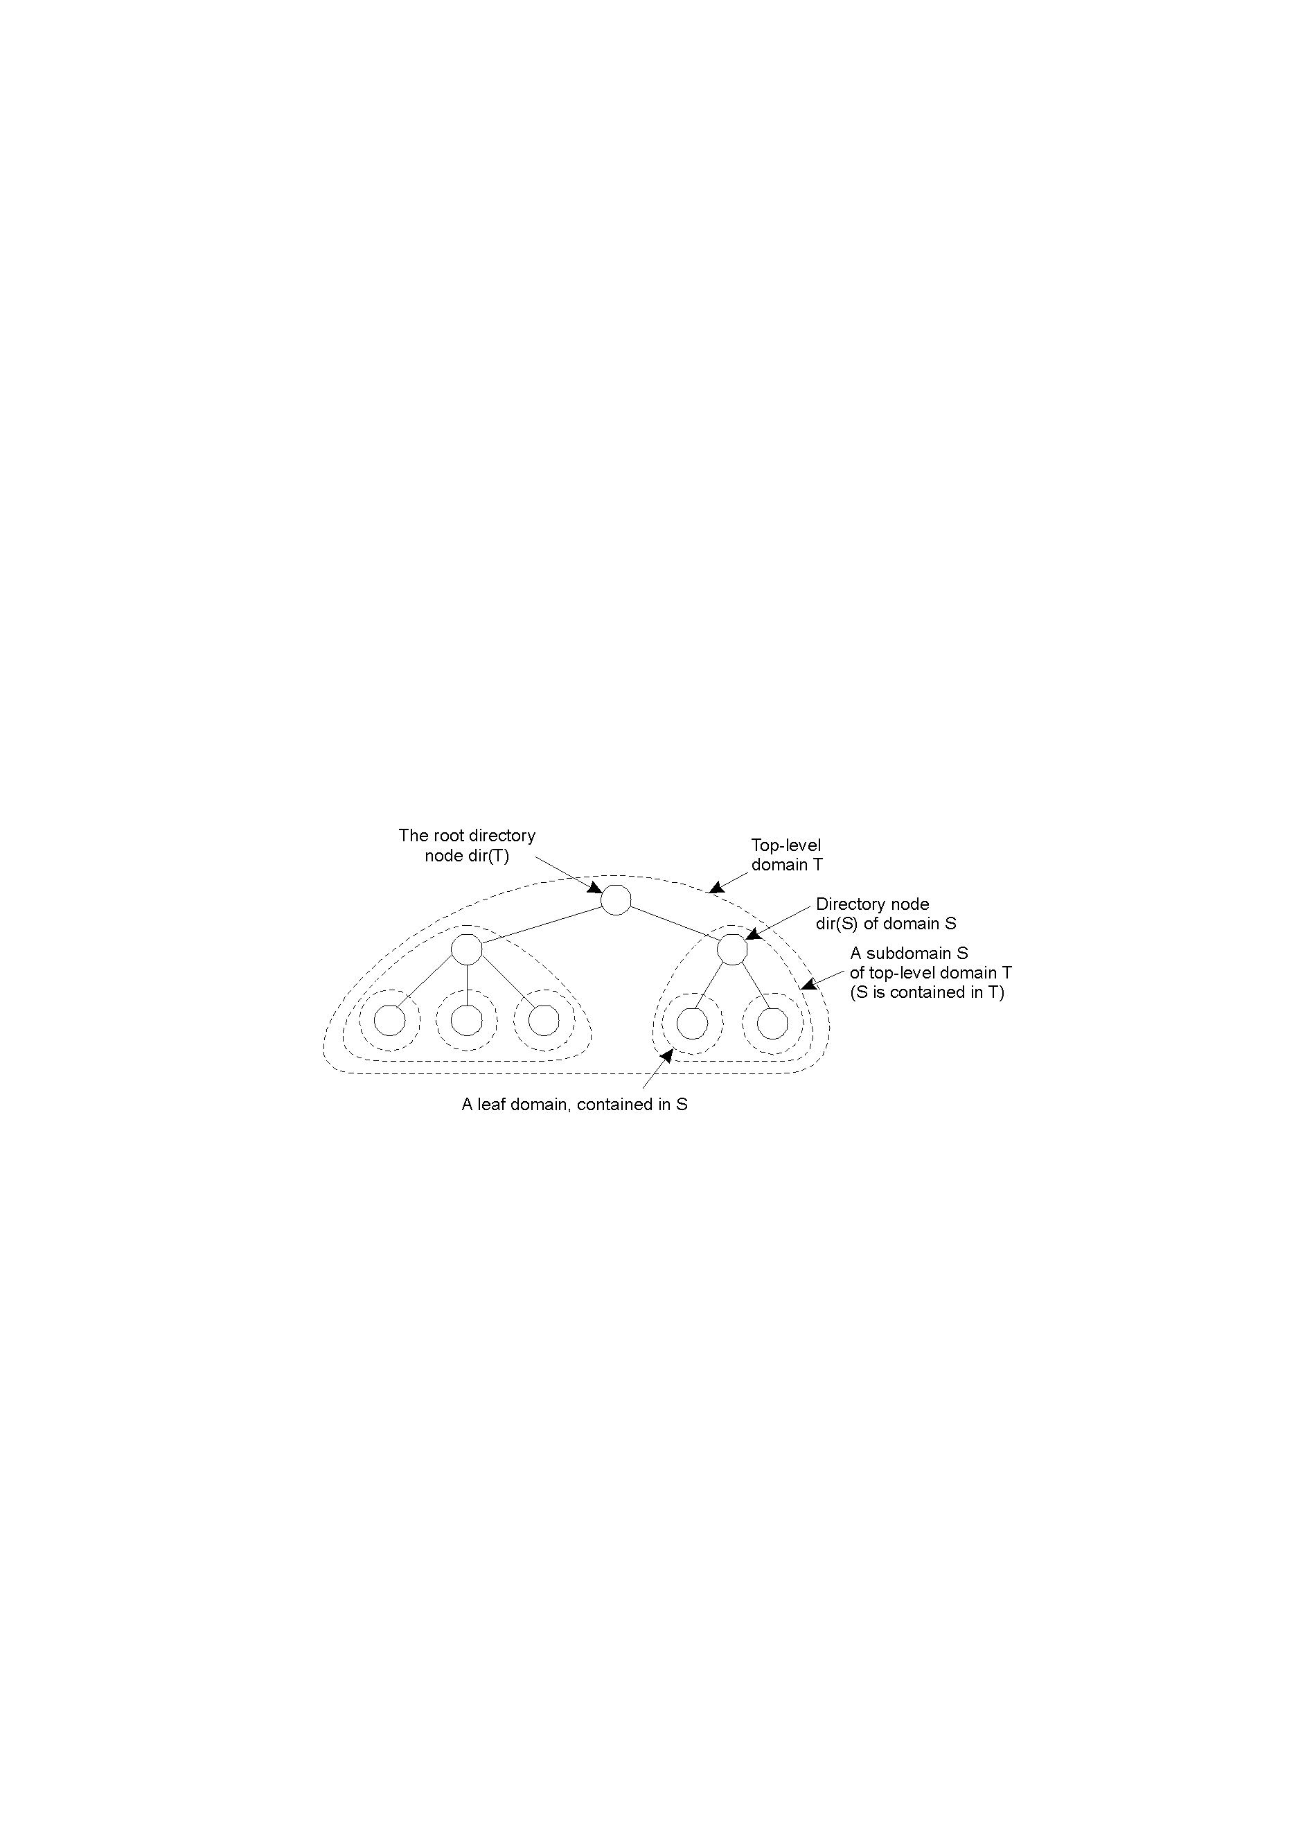
Hierarchical Location Services (HLS)
Basic idea: Build a large-scale search tree for which the underlying network is divided into hierarchical domains. Each domain is represented by a separate directory node.
Leaf domains typically correspond to a local-area network or a cell
The root (directory) node knows all the entities
Each entity currently in a domain D is represented by a location record in the directory node dir(D) which is the entity’s current address or a pointer
Notes:
Hierarchical organization of a location service into domains, each having an associated directory node.
定位实体所使用的基于起始位置的两层方法可以推广到多层。
每个域D都拥有关联的目录节点dir(D)，dir(D)会持续跟踪域的实体，这样就形成了一棵目录节点树。顶级域的目录节点称为根（目录）节点，它包括了全部实体。
为了持续跟踪实体的位置，每个目前位于域D内的实体都由一条在目录节点dir(D)中的位置记录来代表。在叶域D的目录节点N中，实体E的位置记录包含该实体当前在域中的位置。

Slide 16
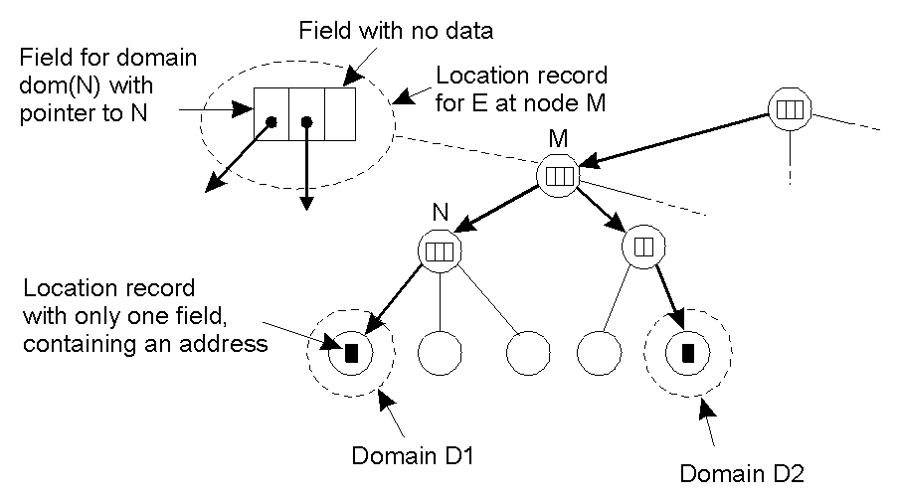
HLS: Tree Organization
The address of an entity is stored in a leaf node, or in an intermediate node
Intermediate nodes contain a pointer to a child if and only if the subtree rooted at the child stores an address of the entity
The root knows about all entities
An entity may have multiple addresses (e.g., if it is replicated)
Notes:
An example of storing information of an entity having two addresses in different leaf domains.
This shows how replicas are represented.
To keep track of the whereabouts of an entity, each entity currently located in a domain D is represented by a location record.

Slide 17
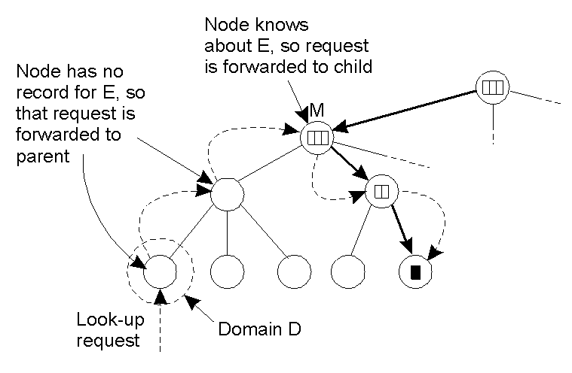
HLS: Lookup Operation
Basic principles:
  Start lookup at local leaf node
  If node knows about the entity, follow downward pointer, otherwise go one level up
  Upward lookup always stops at root
Notes:
Looking up a location in a hierarchically organized location service.

Slide 18
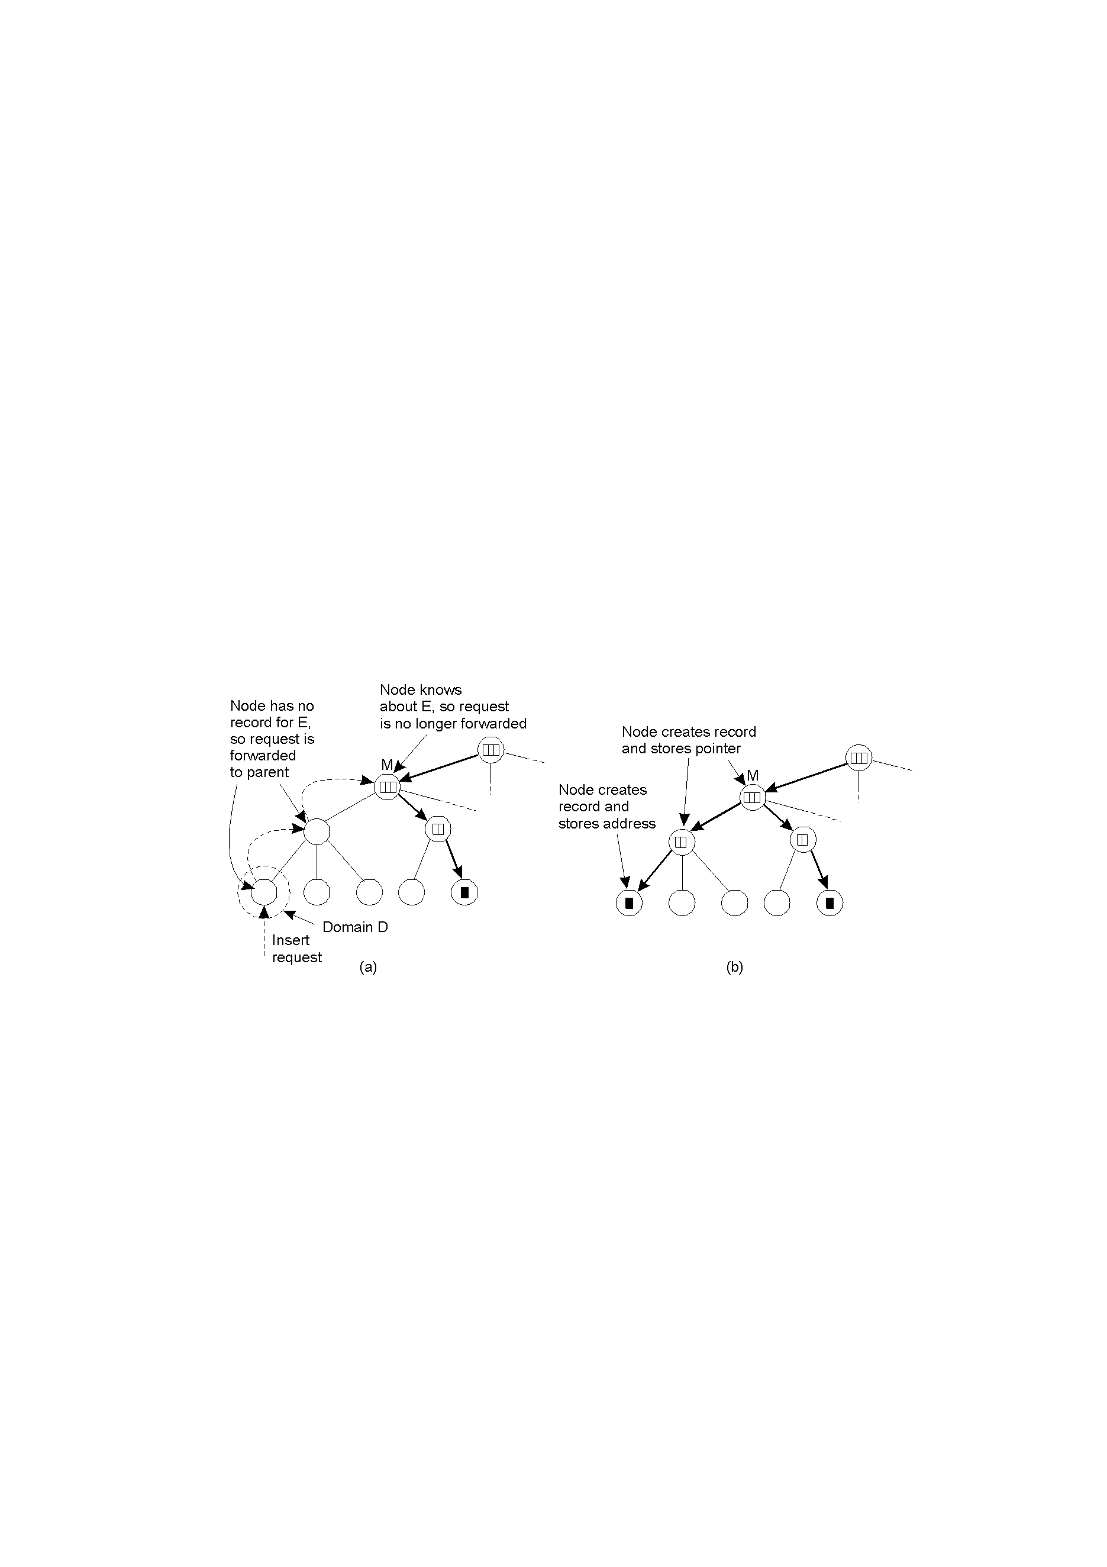
HLS: Insert Operation
Notes:
假设实体E在叶域D中创建了一个复制实体，需要在这个复制实体中插入E的地址。
Consider an entity E that has created a replica in leaf domain D for which it needs to insert its address.

Slide 19
5.3 Structured Naming
Name Space
Name Resolution
The Implementation of a Name Space
Example: The Domain Name System
Notes:
flat names are good for machines, but are generally not very convenient for humans to use. As an alternative, naming systems generally support structured names that are composed from simple human readable names.

Slide 20
Name Space
Names organized into a name space
A name space a collection of valid names recognized by a particular service
Names may have an internal structure that represents their position if a hierarchical name space
Main advantages:
  Each part of a name is resolved relative to a separate context
  Potentially infinite
  Different contexts managed by different entities

Slide 21
Name Spaces
The name space is the way that names in a particular system are organized. This also defines the set of all possible names.
Examples:
  Phone numbers
  Credit card numbers
  DNS
  Human names in the US
  Robert Ludlum books
  Files in UNIX, Windows
  URLs
Notes:
分布式系统的名称都组织在通常所说的名称空间（name space）中。名称空间可以表示为带有标注的具有两种类型的节点的有向图。
http://en.wikipedia.org/wiki/Namespace
In general, a namespace is an abstract container providing context for the items (names, or technical terms, or words) it holds and allowing disambiguation of items having the same name (residing in different namespaces).
As a rule, names in a namespace cannot have more than one meaning, that is, two or more things cannot share the same name. A namespace is also called a context, as the valid meaning of a name can change depending on what namespace applies. Names in it can represent objects as well as concept, whether it is a natural or ethnic language, a constructed language, the technical terminology of a profession, a dialect, a sociolect, or an artificial language (e.g., a programming language).
For many programming languages, a namespace is a context for identifiers. In an operating system, an example of namespace is a directory. It contains items which must have unique names. In the Java programming language, items that appear in namespaces have a short (local) name and unique long "qualified" names for use outside the name space. Also, some languages (such as C++) combine namespace and names in a process called name mangling in order to eradicate ambiguity.

Slide 22
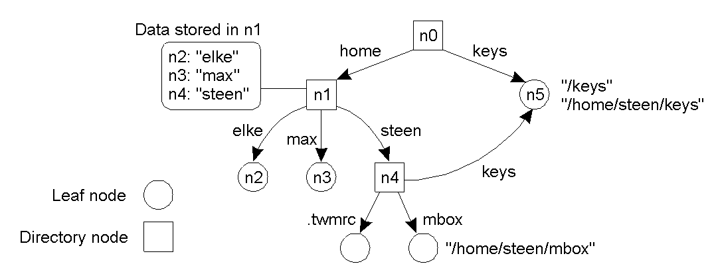
Name Space (1/2)
A (hierarchical) name space can be represented as a labeled, directed graph (naming graph) with two types of nodes.
  a leaf node represents a (named) entity.
  A directory node refers to other nodes; a directory node stores a (directory) table of (edge label, node identifier) pairs.
Notes:
Path, local name, absolute name
Should it be a tree, DAG(Directed acyclic graph), allow cycles?
Cycles might be convenient, if we want to order things more.
Tree will prevent multiple names.

Slide 23
Name Space (2/2)
Observation: We can easily store all kinds of attributes in a node, describing aspects of the entity the node represents:
  Type of the entity
  An identifier for that entity
  Address of the entity’s location
  Nicknames
  ...
Observation: Directory nodes can also have attributes, besides just storing a directory table with (edge label, node identifier) pairs.

Slide 24
Name Resolution
Looking up a name (finding the “value”) is called name resolution.
Problem: To resolve a name we need a directory node. How do we actually find that (initial) node?
Closure mechanism (or where to start)
  The mechanism to select the implicit context from which to start name resolution. Examples, file systems, ZIP code, DNS
    www.cs.vu.nl: start at a DNS name server
    /home/steen/mbox: start at the local NFS file server (possible recursive search)
    0031204447784: dial a phone number
    130.37.24.8: route to the VU’s Web server
Question: Why are closure mechanisms always implicit?
Observation: A closure mechanism may also determine how name resolution should proceed
Notes:
Question: Why are closure mechanisms always implicit?
http://www.rocw.raifoundation.org/computing/BCA/distributedcomputing/lecture-notes/lecture-13.pdf
Recursive Name Resolution
A problem with name resolution is how to determine which node to start resolution at. Knowing how and where to start
name resolution is referred to as the closure mechanism. One approach is to keep an external reference (e.g., in a file) to the root node of the name space. Another approach is to keep a reference to the ‘current’ directory node for dealing with relative names. Note that the actual closure mechanism is always implicit, that is it is never explicitly defined in a name. The reason for this is that if a closure mechanism was defined in a name there would have to be a way to resolve the name used for that closure mechanism. This would require the use of a closure mechanism to bootstrap the original closure mechanism. Because this could be repeated indefinitely, at a certain point an implicit mechanism will always be required.

Slide 25
Name Linking (1/2)
Hard link: What we have described so far as a path name: a name that is resolved by following a specific path in a naming graph from one node to another.
Soft link: Allow a node O to contain a name of another node:
  First resolve O ’ s name (leading to O)
  Read the content of O, yielding name
  Name resolution continues with name
Observations:
  The name resolution process determines that we read the content of a node, in particular, the name in the other node that we need to go to.
  One way or the other, we know where and how to start name resolution given name
Notes:
A hard alias would be like two ZIP codes to the same place.
A soft alias would be like a forwarding address.
与名字解析过程密切相关的一个问题是如何处理别名（alias）。顾名思义，别名是一个名字的另一种表现形式，与该名字一起绑定到一个实体。在一个名字空间里，有两种可以选择的别名处理方法。第一种允许多条绝对路径指向图中的同一个节点。第二种方法对应于纯树形结构，用一个特殊节点代表一个别名，这类终节点不存放实体的地址及属性，而存放一条绝对路径名，对这个路径进行进一步解析，便可以找到所绑定的实体。

Slide 26
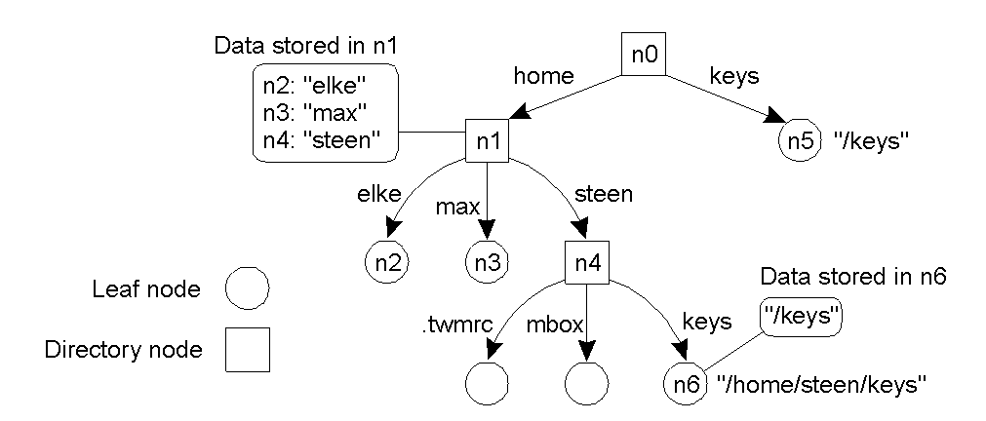
Name Linking (2/2)
Observation: Node n5 has only one name
Notes:
The concept of a symbolic link explained in a naming graph.
对应于纯树形结构，用一个特殊节点代表一个别名，这类终节点不存放实体的地址及属性，而存放一条绝对路径名，对这个路径进行进一步解析，便可以找到所绑定的实体。

Slide 27
Name Space Implementation
Name spaces always map names to something.
  DNS maps what to what?
Can be divided into three layers:
  Global layer: Doesn’t change very often.
    根目录和最靠近根目录的一些节点组成
  Administrational layer: Single organization
    一般隶属于某一个组织或团体类型之下，每一个子节点代表某一特定组织
  Managerial layer: Change regularly
    可以是目录节点，也可以是终结点
Notes:
一个高效、可靠、对用户友好的命名服务系统之关键是命名空间，而实现命名空间的各种服务，如查询、注册、删除、维护等，就要借助于命名服务器。如果一个命名空间只作用于一个局域网，一台命名服务器就足以胜任，而对于大规模分布式系统而言，可能就需要把命名服务及管理任务分不到多台服务器上。
命名服务系统要管理一个巨大的名字数据库，要保证这个数据库的一致性和完整性。大多数分布式命名管理系统都采用层次结构来划分逻辑管理功能。

Slide 28
Name Space Implementation
Basic issue: Distribute the name resolution process as well as name space management across multiple machines, by distributing nodes of the naming graph.
Consider a hierarchical naming graph and distinguish three levels:
  Global level: Consists of the high-level directory nodes. Main aspect is that these directory nodes have to be jointly managed by different administrations
  Administrational level: Contains mid-level directory nodes that can be grouped in such a way that each group can be assigned to a separate administration.
  Managerial level: Consists of low-level directory nodes within a single administration. Main issue is effectively mapping directory nodes to local name servers.
Notes:
一个高效、可靠、对用户友好的命名服务系统之关键是命名空间，而实现命名空间的各种服务，如查询、注册、删除、维护等，就要借助于命名服务器。如果一个命名空间只作用于一个局域网，一台命名服务器就足以胜任，而对于大规模分布式系统而言，可能就需要把命名服务及管理任务分不到多台服务器上。
命名服务系统要管理一个巨大的名字数据库，要保证这个数据库的一致性和完整性。大多数分布式命名管理系统都采用层次结构来划分逻辑管理功能。

Slide 29
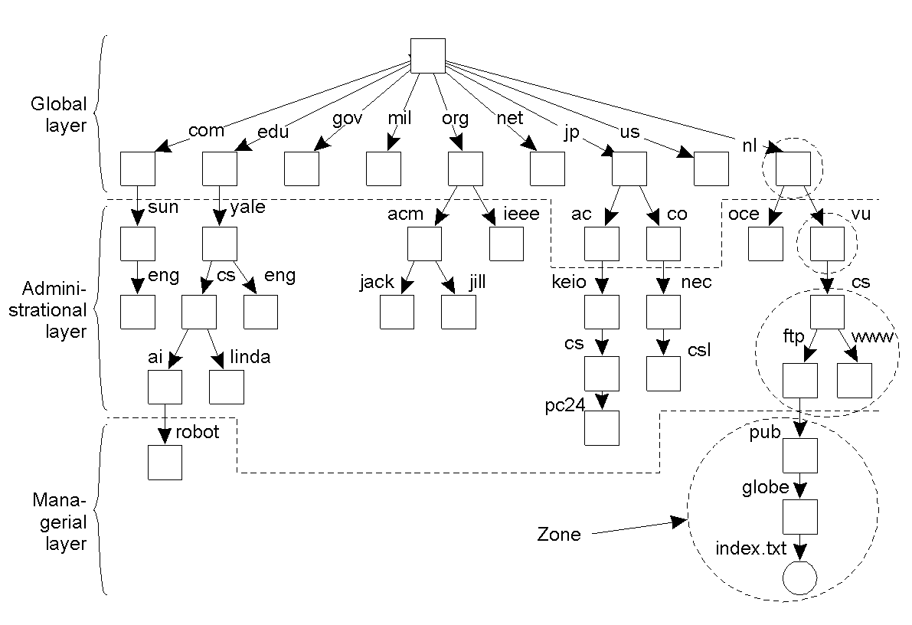
Name Space Distribution
An example partitioning of the DNS name space, including Internet-accessible files, into three layers.
Notes:
Does performance of the top layer need to be fast?
How to improve performance?
In contrast to the global and administrational layer, the nodes in the managerial layer are maintained not only by system administrators, but also by individual end users of a distributed system.
名称空间划分成不重叠的几部分，在DNS中称为区域（zone）。区域是名称空间的一部分，它是由单独的名称服务器实现的。

Slide 30
Name Server Characteristics
Item | Global | Administrational | Managerial
Geographical scale of network | Worldwide | Organization | Department
Total number of nodes | Few | Many | Vast numbers
Responsiveness to lookups | Seconds | Milliseconds | Immediate
Update propagation | Lazy | Immediate | Immediate
Number of replicas | Many | None or few | None
Is client-side caching applied? | Yes | Yes | Sometimes
A comparison between name servers for implementing nodes from a large-scale name space partitioned into a global layer, as an administrational layer, and a managerial layer.
Notes:
在可用性和性能方面，每层的名称服务器都必须满足不同的要求。在分布式系统中，全局层和行政层的名称服务器非常难以实现，困难来自于复制和缓存。复制和缓存对于提高可用性和性能来说是必需的，但它们也导致了一致性的问题。跨越广域网络的缓存和复制使问题进一步恶化，这是因为广域网络造成了较长的通信延迟，从而使同步变得更加困难。

Slide 31
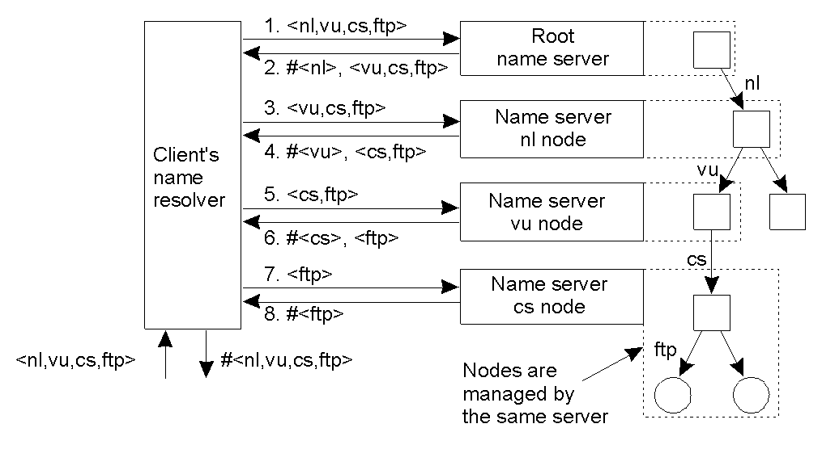
Iterative Name Resolution
resolve(dir,[name1,...,nameK]) is sent to Server0 responsible for dir
Server0 resolves resolve(dir,name1) → dir1, returning the identification (address) of Server1, which stores dir1.
Client sends resolve(dir1,[name2,...,nameK]) to Server1, etc.
Notes:
Consider the name root:<nl, vu, cs, ftp, pub, globe, index.txt>.
How could you improve this?

Slide 32
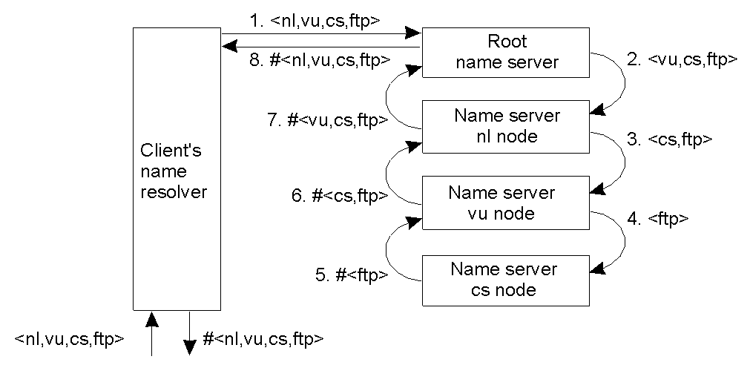
Recursive Name Resolution
resolve(dir,[name1,...,nameK]) is sent to Server0 responsible for dir
Server0 resolves resolve(dir,name1) →dir1, and sends resolve(dir1,[name2,...,nameK]) to Server1, which stores dir1.
Server0 waits for the result from Server1, and returns it to the client.
Notes:
The principle of recursive name resolution.
Advantages

Slide 33
Caching in Recursive Name Resolution
Server for node | Should resolve | Looks up | Passes to child | Receives and caches | Returns to requester
cs | <ftp> | #<ftp> | -- | -- | #<ftp>
vu | <cs,ftp> | #<cs> | <ftp> | #<ftp> | #<cs> #<cs, ftp>
ni | <vu,cs,ftp> | #<vu> | <cs,ftp> | #<cs> #<cs,ftp> | #<vu> #<vu,cs> #<vu,cs,ftp>
root | <ni,vu,cs,ftp> | #<nl> | <vu,cs,ftp> | #<vu> #<vu,cs> #<vu,cs,ftp> | #<nl> #<nl,vu> #<nl,vu,cs> #<nl,vu,cs,ftp>
Recursive name resolution of <nl, vu, cs, ftp>. Name servers cache intermediate results for subsequent lookups.
Is iterative or recursive better for caching?
Notes:
Recursive can make more effective use of caching, since more requests will go through a single thing.
如果使用迭代名称解析，那么就需要把缓存限制在客户的名称解析程序上。
递归解析的第二个优点是它在通信方面的开销通常较小。

Slide 34
Scalability Issues (1/2)
Size scalability: We need to ensure that servers can handle a large number of requests per time unit ⇒ high-level servers are in big trouble.
Solution: Assume (at least at global and administrational level) that content of nodes hardly ever changes. In that case, we can apply extensive replication by mapping nodes to multiple servers, and start name resolution at the nearest server.
Observation: An important attribute of many nodes is the address where the represented entity can be contacted. Replicating nodes makes large-scale traditional name servers unsuitable for locating mobile entities.
Notes:
It puts a higher performance demand on each name server. Name servers in the global layer of a name space support only iterative name resolution.

Slide 35
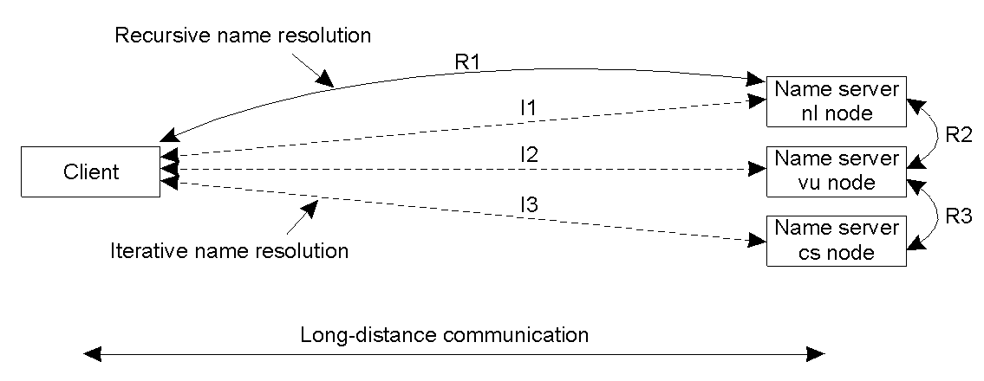
Scalability Issues (2/2)
Geographical scalability: We need to ensure that the name resolution process scales across large geographical distances.
Problem: By mapping nodes to servers that may, in principle, be located anywhere, we introduce an implicit location dependency in our naming scheme.
Notes:
Is there any downside to recursive?

Slide 36
Example: Decentralized DNS
Basic idea: Take a full DNS name, hash into a key k, and use a DHT-based system to allow for key lookups.
Main drawback: You can’t ask for all nodes in a subdomain (but very few people were doing this anyway).
Information in a node: Typically what you find in a DNS record, of which there are different kinds:
Type of record | Associated entity | Description
SOA | Zone | Holds information on the represented zone
A | Host | Contains an IP address of the host this node represents
MX | Domain | Refers to a mail server to handle mail addressed to this node
SRV | Domain | Refers to a server handling a specific service
NS | Zone | Refers to a name server that implements the represented zone
PTR | Node | Symbolic link with the primary name of the represented node
CNAME | Host | Contains the canonical name of a host
HINFO | Host | Holds information on the host this node represents
TXT | Any kind | Contains any entity-specific information considered useful
Notes:
The obvious draw of this approach is that we lose the structure of the original name. This loss may prevent efficient implementations of for example, finding all children in a specific domain.
The most important types of resource records forming the contents of nodes in the DNS name space.
Contents of a node. Note that these are usually not stored with the node itself.

Slide 37
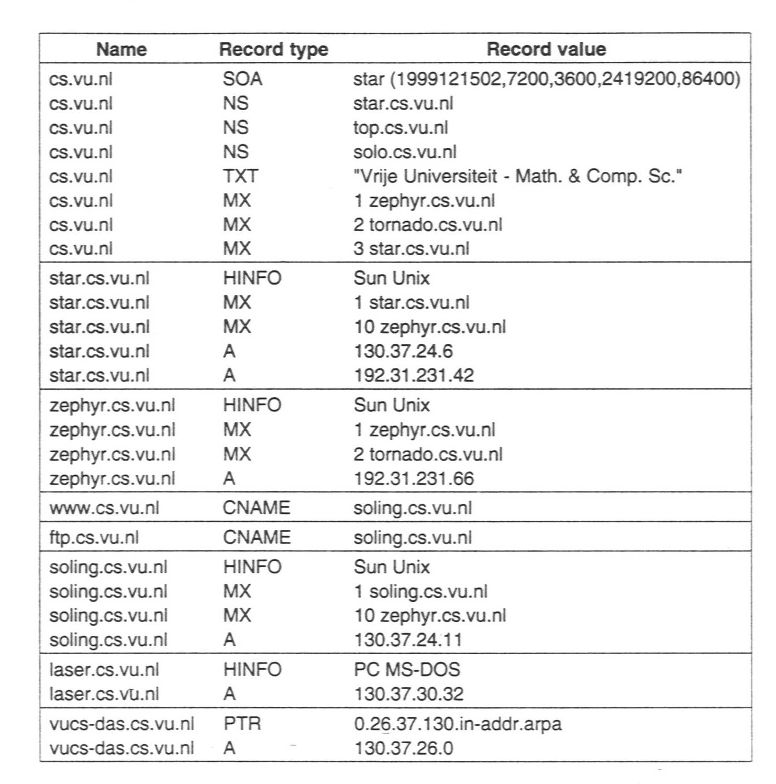
Notes:
The node cs.vu.nl represents the domain as well as the zone. Its SOA resource record contains specific information on the validity of this file.
主机star.cs.vu.nl作为这个区域的一个名称服务器运行。名称服务器对于任何名称服务都是很关键的。可以看到，为了增强这个服务器的健壮性，提供了两个分开的网络接口，每一个都由一条独立的A资源记录来代表。

Slide 38
DNS on Pastry
Pastry: DHT-based system that works with prefixes of keys. Consider a system in which keys come from a 4-digit number space. A node with ID 3210 keeps track of the following nodes:
      n0 a node whose identifier has prefix 0
      n1 a node whose identifier has prefix 1
      n2 a node whose identifier has prefix 2
      n30 a node whose identifier has prefix 30
      n31 a node whose identifier has prefix 31
      n33 a node whose identifier has prefix 33
      n320 a node whose identifier has prefix 320
      n322 a node whose identifier has prefix 322
      n323 a node whose identifier has prefix 323
Note: Node 3210 is responsible for handling keys with prefix 321. If it receives a request for key 3012, it will forward the request to node n30.
Notes:
DNS: A node responsible for key k stores DNS records of names with hash value k.

Slide 39

Replication of Records (1/2)
Definition: replicated at level i – record is replicated to all nodes with i matching prefixes. Note: # hops for looking up record at level i is generally i.
Observation: Let xi denote the fraction of most popular DNS names of which the records should be replicated at level i, then:
with N is the total number of nodes, d = b(1−α)/α and α≈1, assuming that popularity follows a Zipf distribution:
The frequency of the n-th ranked item is proportional to 1/nª

Slide 40
Replication of Records (1/2)
What does this mean? If you want to reach an average of C = 1 hops when looking up a DNS record, then with b = 4, α = 0.9, N = 10,000 and 1, 000,000 records that
    61 most popular records should be replicated at level 0
    284 next most popular records at level 1
    1323 next most popular records at level 2
    6177 next most popular records at level 3
    28826 next most popular records at level 4
    134505 next most popular records at level 5
    the rest should not be replicated

Slide 41
5.4 Attribute_Based Naming
Notes:
5.4 Finally, humans often prefer to describe entities by means of various characteristics, leading to a situation in which we need to resolve a description by means of attributes to an entity adhering to that description. This type of name resolution is notoriously difficult and we will pay separate attention to it.

Slide 42
Attribute-Based Naming
Observation: In many cases, it is much more convenient to name, and look up entities by means of their attributes ⇒ traditional directory services (a.k.a., yellow pages).
Problem: Lookup operations can be extremely expensive, as they require to match requested attribute values, against actual attribute values ⇒ inspect all entities (in principle).
Solution: Implement basic directory service as database, and combine with traditional structured naming system.
Notes:
Finally, humans often prefer to describe entities by means of various characteristics, leading to a situation in which we need to resolve a description by means of attributes to en entity adhering to that description. This type of name resolution is notoriously difficult and we will pay separate attention to it.
。。。。。。。。
5.4. Attribute-Based Naming
Flat and structured names generally provide a unique and location-independent way of referring to entities. Moreover, structured names have been partly designed to provide a human-friendly way to name entities so that they can be conveniently accessed. In most cases, it is assumed that the name refers to only a single entity. However, location independence and human friendliness are not the only criterion for naming entities. In particular, as more information is being made available it becomes important to effectively search for entities. This approach requires that a user can provide merely a description of what he is looking for.
There are many ways in which descriptions can be provided, but a popular one in distributed systems is to describe an entity in terms of (attribute, value) pairs, generally referred to as attribute-based naming. In this approach, an entity is assumed to have an associated collection of attributes. Each attribute says something about that entity. By specifying which values a specific attribute should have, a user essentially constrains the set of entities that he is interested in. It is up to the naming system to return one or more entities that meet the user's description. In this section we take a closer look at attributed-based naming systems.
。。。。。。。。。。
More problematic are attribute-based naming schemes in which entities are described by a collection of (attribute, value) pairs. Queries are also formulated as such pairs, essentially requiring an exhaustive search through all descriptors. Such a search is only feasible when the descriptors are stored in a single database. However, alternative solutions have been devised by which the pairs are mapped onto DHT-based systems, essentially leading to a distribution of the collection of entity descriptors.
Related to attribute-based naming is to gradually replace name resolution by distributed search techniques. This approach is followed in semantic overlay networks, in which nodes maintain a local list of other nodes that have semantically similar content. These semantic lists allow for efficient search to take place by which first the immediate neighbors are queried, and only after that has had no success will a (limited) broadcast be deployed.

Slide 43
X.500 Directory Service
provides directory service based on a description of properties instead of a full name (e.g., yellow pages in telephone book)
an X.500 directory entry is comparable to a resource record in DNS. Each record is made up of a collection of (attribute, value) pairs
Collection of all entries is a Directory Information Base (DIB)
Each naming attribute is a Relative Distinguished Name (RDN)
RDNs, in sequence, can be used to form a Directory Information Tree (DIT)
Notes:
DNS resolves a name to a node in the namespace graph.
X.500 is a directory service, which allows more general queries. Consists of a set of records. Each record is a list of attribute-value pairs, with possible multiple values.

Slide 44
X.500 Directory Entry
Attribute | Abbr. | Value
Country | C | CN
Locality | L | Beijing
Organization | O | Peking University
OrganizationalUnit | OU | School of EECS
CommonName | CN | Main server
Mail_Servers | -- | 162.105.203.25
FTP_Server | -- | 162.105.146.3
WWW_Server | -- | 162.105.203.25
A simple example of a X.500 directory entry using X.500 naming conventions.
  /C=CN/O=Peking University/OU=School of EECS
  is analogous to the DNS name eecs.pku.edu.cn
Notes:
Note the multi-values.

Slide 45
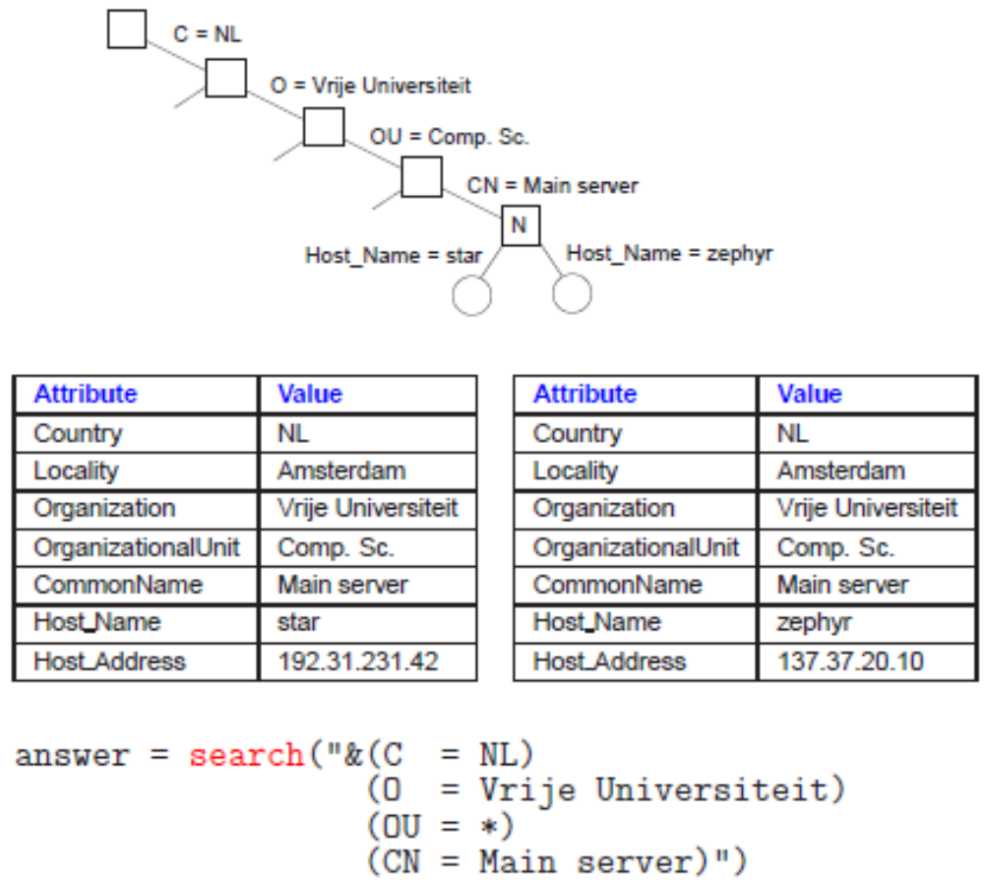
Example: LDAP
Notes:
To accommodate X.500 directory sevices in the Internet, a simplified protocol has been devised, known as the Light-weight Directory Access Protocol (LDAP).
Simplified X.500 is LDAP.LDAP is an application-level protocol that is implemented directly on top of TCP.LDAP is gradually becoming a de facto standard for Internet-based directory services.
Two directory entries having Host_Name as RDN.

